Slide 1

Data Structures Using C++ 2E
Chapter 6
Recursion

Slide 2
Objectives
Learn about recursive definitions
Explore the base case and the general case of a recursive definition
Learn about recursive algorithm
Learn about recursive functions
Explore how to use recursive functions to implement recursive algorithms
Data Structures Using C++ 2E

Slide 3
Recursive Definitions
Recursion
  Process of solving a problem by reducing it to smaller versions of itself
Example: factorial problem
  5! = 5 x 4 x 3 x 2 x 1 = 120
  If n is a nonnegative, factorial of n (i.e., n!) defined as
  0! = 1 Eq 6-1
  n! = n x (n – 1)! if n > 0 Eq 6-2
Base case: solution obtained directly
General case: solution obtained indirectly using recursion
Smaller version of itself
Data Structures Using C++ 2E

Slide 4
Recursive Definitions (cont’d.)
Recursion insight gained from factorial problem
  Every recursive definition must have one (or more) base cases
  General case must eventually reduce to a base case
  Base case stops recursion
Recursive algorithm
  Finds problem solution by reducing problem to smaller versions of itself
Recursive function
  Function that calls itself
Data Structures Using C++ 2E

Slide 5
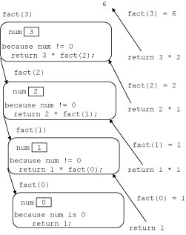
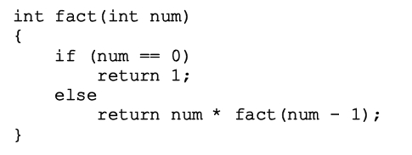
Recursive Definitions (cont’d.)
Recursive function implementing the factorial function
Data Structures Using C++ 2E
FIGURE 6-1 Execution of fact(4)

Slide 6
Recursive Definitions (cont’d.)
Recursive function notable comments
  Recursive function has unlimited number of copies of itself (logically)
  Every call to a recursive function has its own
    Code, set of parameters, local variables
  After completing a particular recursive call
    Control goes back to calling environment (previous call)
    Current (recursive) call must execute completely before control goes back to the previous call
    Execution in previous call begins from point immediately following the recursive call
Data Structures Using C++ 2E

Slide 7
Recursive Definitions (cont’d.)
Direct and indirect recursion
  Directly recursive function
    Calls itself
  Indirectly recursive function
    Calls another function, eventually results in original function call
    Requires same analysis as direct recursion
    Base cases must be identified, appropriate solutions to them provided
    Tracing can be tedious
  Tail recursive function
    Last statement executed: the recursive call, e.g., factorial
Data Structures Using C++ 2E

Slide 8
Recursive Definitions (cont’d.)
Infinite recursion
  Occurs if every recursive call results in another recursive call
  Executes forever (in theory)
  Call requirements for recursive functions
    System memory for local variables and formal parameters
    Saving information for transfer back to right caller
  Finite system memory leads to
    Execution until system runs out of memory
    Abnormal termination of infinite recursive function
Data Structures Using C++ 2E

Slide 9
Recursive Definitions (cont’d.)
Requirements to design a recursive function
  Understand problem requirements
  Determine limiting conditions
  Identify base cases, providing direct solution to each base case
  Identify general cases, providing solution to each general case in terms of smaller versions of itself
No global/static variables! Pass program state as parameters of recursive function
Data Structures Using C++ 2E

Slide 10
In Class Exercises
int func(int x)
{
if (x == 0)
return 2;
else if (x == 1)
return 3;
else
return (func(x - 1) + func(x - 2));
}
void f(char ch)
{
if ((‘A’ <= ch) && (ch <= ‘H’)) {
f(ch-1);
cout << ch;
} else
cout << endl;
}
f(‘C’)
f(‘G’)
f(‘3’)
f(‘C’) if ch-1 is replaced by ch+1 in the function
f(‘C’) if the output statement and the recursive
function call to f() are interchanged
func(5) = ?
Data Structures Using C++ 2E
Notes:
1. What is the base case? What is the general case?
Func(5) = func(4) + func(3) = func(3) + func(2) + func(2) + func(1)= func(2)+ func(1)+func(1)+func(0)+func(1)+func(0)+3=5+3+10+3=21
2.
\newline ABC
\newline ABCDEFG
\newline
\newline HGFEDC
CBA \newline

Slide 11
Largest Element in an Array
FIGURE 6-2 list with six elements
list: array name containing elements
list[a]...list[b] stands for the array elements list[a], list[a + 1], ..., list[b]
Find largest element in list[a]...list[b]
  list length =1
    One element (largest)
  list length >1
  maximum(list[a],largest(list[a + 1]...list[b]))
Data Structures Using C++ 2E

Slide 12
Largest Element in an Array (cont’d.)
FIGURE 6-2 list with six elements
maximum(list[0], largest(list[1]...list[5]))
maximum(list[1], largest(list[2]...list[5]), etc.
Every time previous formula used to find largest element in a sublist
  Length of sublist in next call reduced by one
  Eventually the sublist is of length 1
Data Structures Using C++ 2E

Slide 13
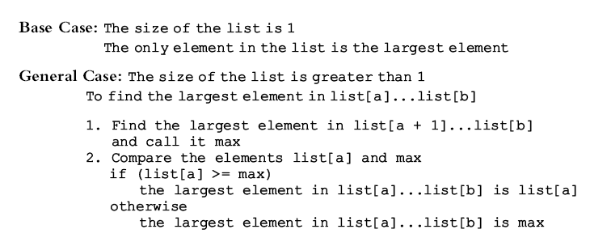
Largest Element in an Array (cont’d.)
Recursive algorithm in pseudocode
Data Structures Using C++ 2E

Slide 14
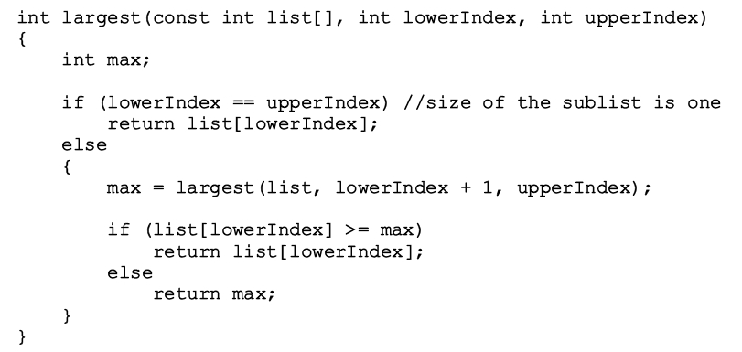
Largest Element in an Array (cont’d.)
Recursive algorithm as a C++ function
Data Structures Using C++ 2E

Slide 15
Largest Element in an Array (cont’d.)
FIGURE 6-3 list with four elements
Trace execution of the following statement
  cout << largest(list, 0, 3) << endl;
Review C++ program on page 362
  Determines largest element in a list
Data Structures Using C++ 2E

Slide 16
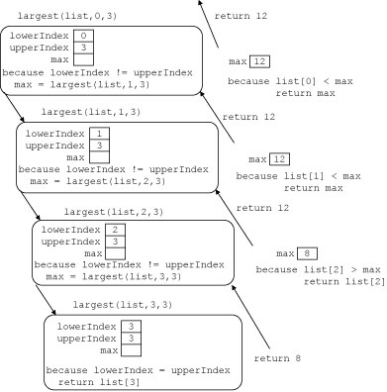
Largest Element in an Array (cont’d.)
No global/static variables! Pass program state as parameters of recursive function
Data Structures Using C++ 2E
FIGURE 6-4 Execution of largest(list, 0, 3)

Slide 17

Print a Linked List in Reverse Order
Function reversePrint
  Given list pointer, prints list elements in reverse order
Figure 6-5 example
  Links in one direction
  Cannot traverse backward starting from last node
FIGURE 6-5 Linked list
Data Structures Using C++ 2E

Slide 18
Print a Linked List in Reverse Order (cont’d.)
Cannot print first node info until remainder of list printed
Cannot print second node info until tail of second node printed, etc.
Every time tail of a node considered
  List size reduced by one
  Eventually list size reduced to zero
  Recursion stops
Data Structures Using C++ 2E

Slide 19
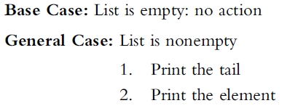
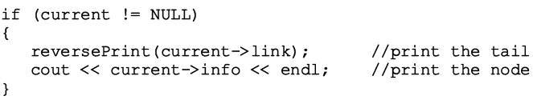
Print a Linked List in Reverse Order (cont’d.)
Recursive algorithm in pseudocode
Recursive algorithm in C++
Data Structures Using C++ 2E

Slide 20
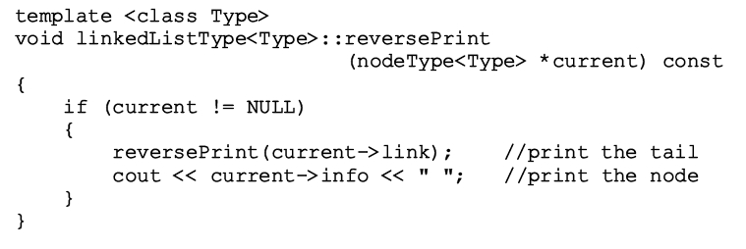
Print a Linked List in Reverse Order (cont’d.)
Function template to implement previous algorithm and then apply it to a list
Data Structures Using C++ 2E

Slide 21
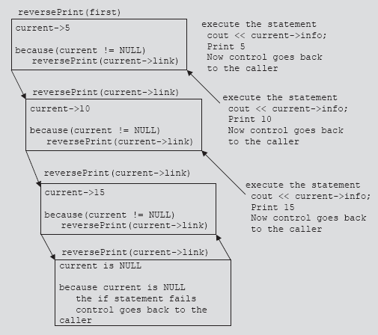
Print a Linked List in Reverse Order (cont’d.)
push current
pop current
push current
pop current
push current
pop current
FIGURE 6-6 Execution of the statement reversePrint(first);
Data Structures Using C++ 2E

Slide 22
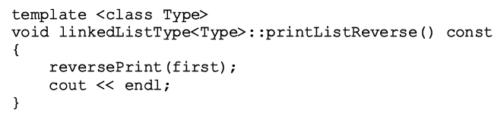
Print a Linked List in Reverse Order (cont’d.)
The function printListReverse
  Prints an ordered linked list contained in an object of the type linkedListType
Data Structures Using C++ 2E

Slide 23
Tips for Recursive Function
Pass necessary state as formal parameters of recursive function
  Each invocation of recursive function can access to the state info before/after making another recursive call
  Do NOT utilize global variable
  Do NOT utilize static variable
Data Structures Using C++ 2E

Slide 24
Fibonacci Number
Sequence: 1, 1, 2, 3, 5, 8, 13, 21, 34, . . .
Sequence: 0, 1, 1, 2, 3, 5, 8, 13, 21, 34, . . .
Given first two numbers (a₁ and a₂)
  nth number a_{n}, n >= 3, of sequence given by: a_{n} = a_{n-1} + a_{n-2}
Recursive function: rFibNum
  Determines desired Fibonacci number
  Parameters: three numbers representing
    first two numbers of the Fibonacci sequence, and
    a number n, the desired nth Fibonacci number
  Returns the nth Fibonacci number in the sequence
Data Structures Using C++ 2E

Slide 25
Fibonacci Number (cont’d.)
Third Fibonacci number
  Sum of first two Fibonacci numbers
Fourth Fibonacci number in a sequence
  Sum of second and third Fibonacci numbers
Calculating fourth Fibonacci number
  Add second Fibonacci number and third Fibonacci number
Data Structures Using C++ 2E

Slide 26
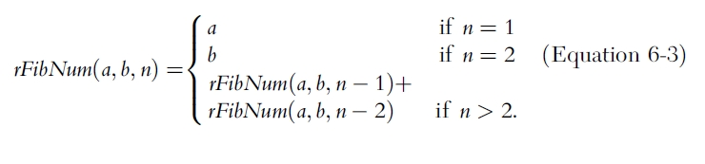
Fibonacci Number (cont’d.)
Recursive algorithm
  Calculates nth Fibonacci number
    a denotes first Fibonacci number
    b denotes second Fibonacci number
    n denotes nth Fibonacci number
Data Structures Using C++ 2E

Slide 27
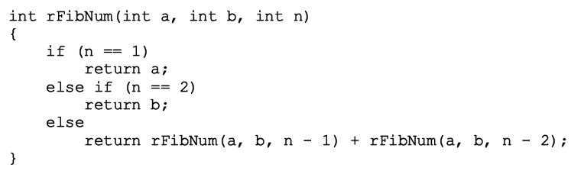
Fibonacci Number (cont’d.)
Recursive function implementing algorithm
Trace code execution
Review code on page 368 illustrating the function rFibNum
Data Structures Using C++ 2E

Slide 28
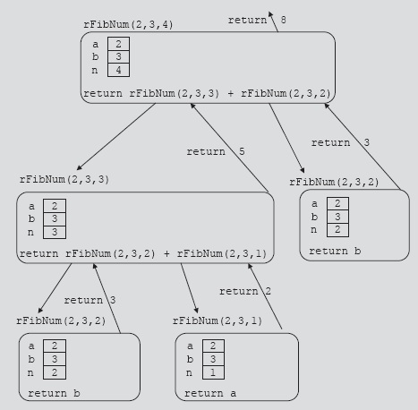
Fibonacci Number (cont’d.)
No global/static variables! Pass program state as parameters of recursive function
Executed twice
FIGURE 6-7 Execution of rFibNum(2, 3, 4)
Data Structures Using C++ 2E

Slide 29
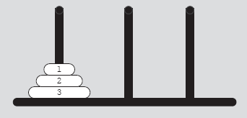
Tower of Hanoi
Env: 3 needles and 64 disks
Objective
  Move 64 disks from first needle to third needle
Rules
  Only one disk can be moved at a time
  Removed disk must be placed on one of the needles
  A larger disk cannot be placed on top of a smaller disk
FIGURE 6-8 Tower of Hanoi problem with three disks
Data Structures Using C++ 2E

Slide 30
Tower of Hanoi (cont’d.)
Case: first needle contains only one disk
  Move disk directly from needle 1 to needle 3
Case: first needle contains only two disks
  Move first disk from needle 1 to needle 2
  Move second disk from needle 1 to needle 3
  Move first disk from needle 2 to needle 3
Case: first needle contains three disks
  Move first two disks from needle 1 to needle 2
  Move disk 3 directly from needle 1 to needle 3
  Move disks 1 & 2 from needle 2 to needle 3
Data Structures Using C++ 2E

Slide 31


Tower of Hanoi (cont’d.)
http://www.cosc.canterbury.ac.nz/mukundan/dsal/ToHdb.html
http://math.rice.edu/~lanius/domath/hanoi.html
Data Structures Using C++ 2E

Slide 32
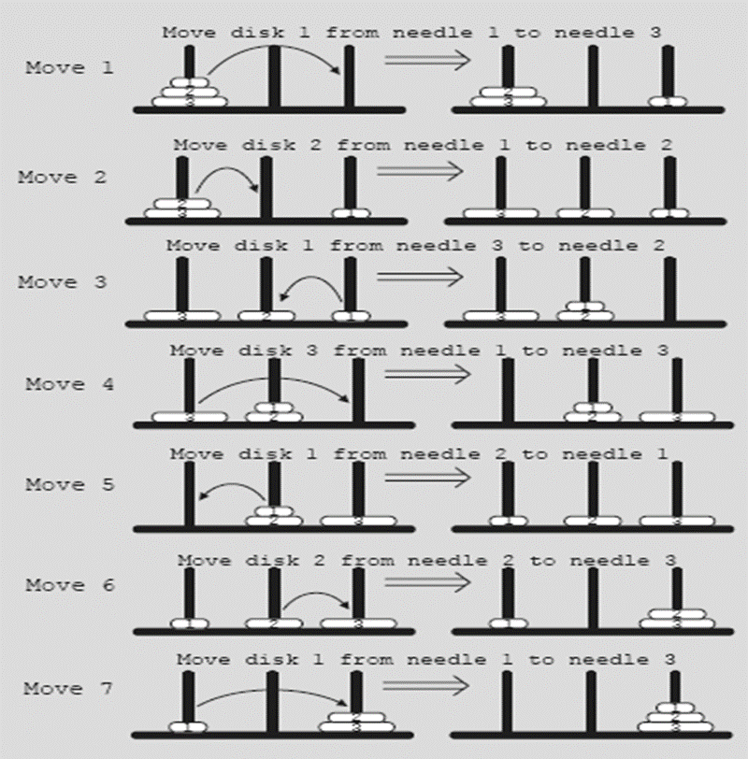
Tower of Hanoi (cont’d.)
FIGURE 6-9 Solution to Tower of Hanoi problem with three disks
Data Structures Using C++ 2E

Slide 33
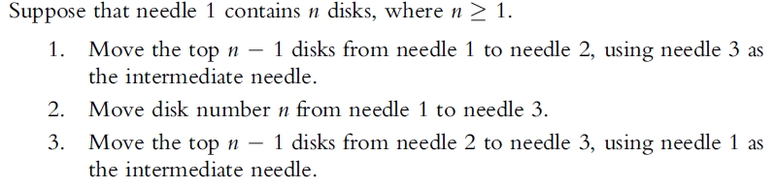
Tower of Hanoi (cont’d.)
Generalize problem to the case of 64 disks
  Recursive algorithm in pseudocode
Data Structures Using C++ 2E

Slide 34
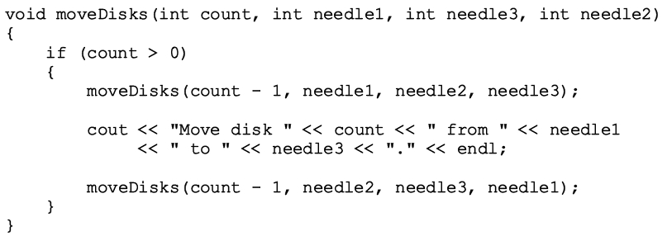
Tower of Hanoi (cont’d.)
Generalize problem to the case of 64 disks
  Recursive algorithm in C++
Data Structures Using C++ 2E

Slide 35
Tower of Hanoi (cont’d.)
Analysis of Tower of Hanoi
  A minimum number of moves of 2^{n} – 1 is needed for n disks
    If n = 3, total 7 moves
  Time necessary to move all 64 disks from needle 1 to needle 3
    2⁶⁴ ~ 1.6 x 10¹⁹
    Manually (1 move/second): roughly 5 x 10¹¹ years ~ 500 billion years
      Universe is about 15 billion years old (1.5 x 10¹⁰)
    Computer (10⁹ moves/second): 500 years
Data Structures Using C++ 2E

Slide 36

Converting a Number from Decimal to Binary
Convert nonnegative integer in decimal format (base 10) into equivalent binary number (base 2)
Rightmost bit of x
  Remainder of x after division by two
Recursive algorithm pseudocode
  Binary(num) denotes binary representation of num
Data Structures Using C++ 2E
Notes:
Right shift a number by 1 bit = num/2
Remainder = num %2

Slide 37
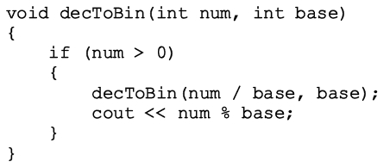
Converting a Number from Decimal to Binary (cont’d.)
Recursive function implementing algorithm
Data Structures Using C++ 2E

Slide 38
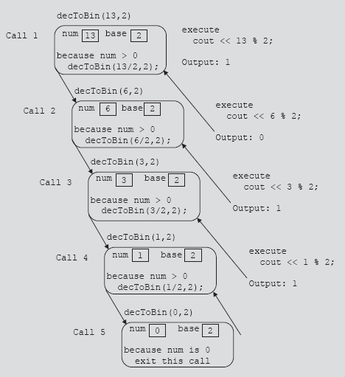
Converting a Number from Decimal to Binary (cont’d.)
No global/static variables! Pass program state as parameters of recursive function
FIGURE 6-10 Execution of decToBin(13, 2)
Data Structures Using C++ 2E

Slide 39
Recursion or Iteration?
Dependent upon nature of the solution and efficiency
Efficiency
  Overhead of recursive function: execution time and memory usage
    Given speed memory of today’s computers, we can depend more on how programmer envisions solution
  Use of programmer’s time
  Any program that can be written recursively can also be written iteratively
Data Structures Using C++ 2E

Slide 40
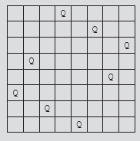
Recursion and Backtracking: 8-Queens Puzzle
8-queens puzzle
  Place 8 queens on a chess-board
    No two queens can attack each other
  Nonattacking queens
    Cannot be in same row, same column, same diagonals
FIGURE 6-11 A solution to the 8-queens puzzle
Data Structures Using C++ 2E

Slide 41
Recursion and Backtracking: 8-Queens Puzzle (cont’d.)
Backtracking algorithm
  Find problem solutions by constructing partial solutions
  Ensures partial solution does not violate requirements
  Extends partial solution toward completion
  If partial solution does not lead to a solution (dead end)
    Algorithm backs up
    Removes most recently added part
    Tries other possibilities
Data Structures Using C++ 2E

Slide 42
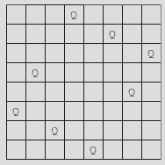
Recursion and Backtracking: 8-Queens Puzzle (cont’d.)
n-Queens Puzzle
  In backtracking, solution represented as
    n-tuple (x₁, x₂, . . ., x_{n})
    Where x_{i} is an integer such that
      1 <= x_{i} <= n
    x_{i} specifies column number, where to place the ith queen in the ith row
  Solution example for Figure 6-11
    (4,6,8,2,7,1,3,5)
    Number of 8-tuple representing a solution: 8!
Data Structures Using C++ 2E

Slide 43
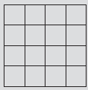


Recursion and Backtracking: 8-Queens Puzzle (cont’d.)
n-Queens Puzzle (cont’d.)
  4-queens puzzle
FIGURE 6-12 Square board for the 4-queens puzzle
FIGURE 6-13 Finding a solution to the 4-queens puzzle
FIGURE 6-14 A solution to the 4-queens puzzle (1,3,0,2)
Data Structures Using C++ 2E

Slide 44
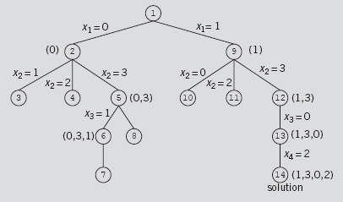
Recursion and Backtracking: 8-Queens Puzzle (cont’d.)
Backtracking and the 4-Queens Puzzle
  Rows and columns numbered zero to three
  Backtracking algorithm can be represented by a tree
FIGURE 6-15 4-queens tree
Data Structures Using C++ 2E

Slide 45
Recursion and Backtracking: 8-Queens Puzzle (cont’d.)
8-Queens Puzzle
  Easy to determine whether two queens in same row or column
  Determine if two queens on same diagonal
    Given queen at position (i, j ), (row i and column j ), and another queen at position (k, l ), (row k and column l )
    Two queens on the same diagonal if |j – l| = |i – k|, where
      |j – l| is the absolute value of j – l and so on
  Solution represented as an 8-tuple
    Use the array queensInRow of size eight
    Where queensInRow[k] specifies column position of the kth queen in row k
Data Structures Using C++ 2E

Slide 46
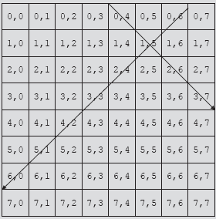
Recursion and Backtracking: 8-Queens Puzzle (cont’d.)
8-Queens Puzzle (cont’d.)
FIGURE 6-16 8 x 8 square board
Data Structures Using C++ 2E

Slide 47
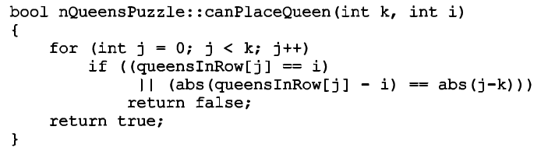
Recursion and Backtracking: 8-Queens Puzzle (cont’d.)
8-Queens Puzzle (cont’d.)
  General algorithm for the function canPlaceQueen(k, i)
Data Structures Using C++ 2E
Notes:
The function returns true if the kth queen can be placed in row k of column i. So far, the first (k-1) queens have been placed already

Slide 48
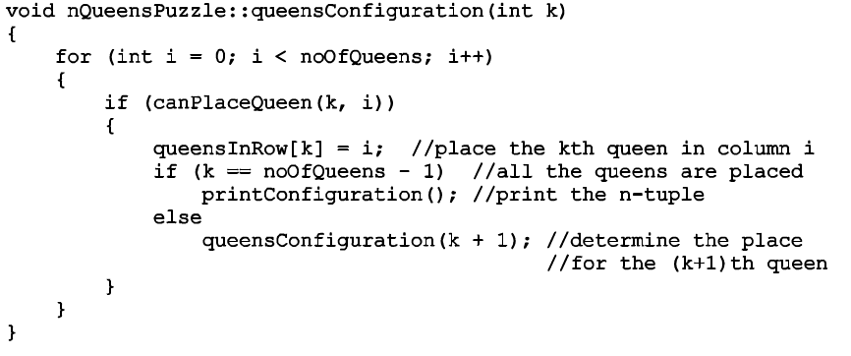
Recursion and Backtracking: 8-Queens Puzzle (cont’d.)
8-Queens Puzzle (cont’d.)
  Implement the backtracking and find all solutions
Data Structures Using C++ 2E
Notes:
queensConfiguration(k) finds all possible 8-queen problem. It essentially goes down the solution trees

Slide 49
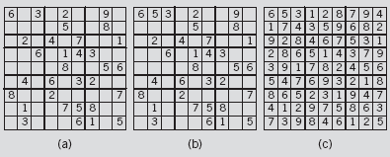
Recursion, Backtracking, and Sudoku
Recursive algorithm
  Start at first row and find empty slot
  Find first number to place in this slot
  Find next empty slot, try to place a number in that slot
  Backtrack if necessary; place different number
  No solution if no number can be placed in slot
Fill the 9x9 grid with numbers 1 to 9 such that each number appears exactly once in each row, each column, and each 3x3 smaller grid
FIGURE 6-17 Sudoku problem and its solution
Data Structures Using C++ 2E

Slide 50
Recursion, Backtracking, and Sudoku (cont’d.)
See code on page 384
  Class implementing Sudoku problem as an ADT
  General algorithm in pseudocode
    Find the position of the first empty slot in the partially filled grid
    If the grid has no empty slots, return true and print the solution
    Suppose the variables row and col specify the position of the empty grid position
Data Structures Using C++ 2E

Slide 51
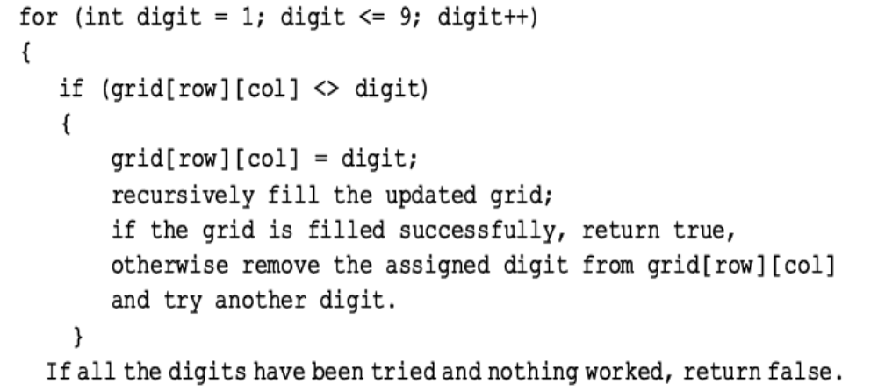
Recursion, Backtracking, and Sudoku (cont’d.)
General algorithm in pseudocode (cont’d.)
Data Structures Using C++ 2E

Slide 52
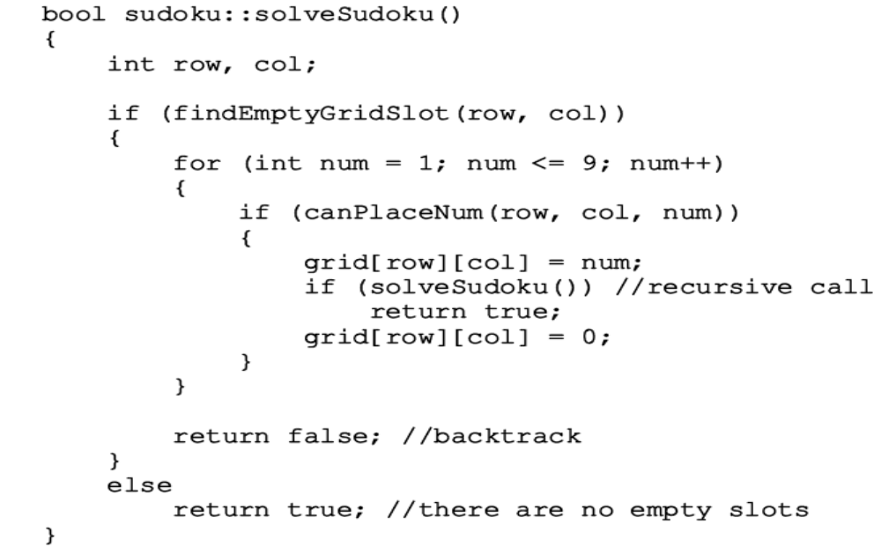
Recursion, Backtracking, and Sudoku (cont’d.)
Function definition
Data Structures Using C++ 2E

Slide 53
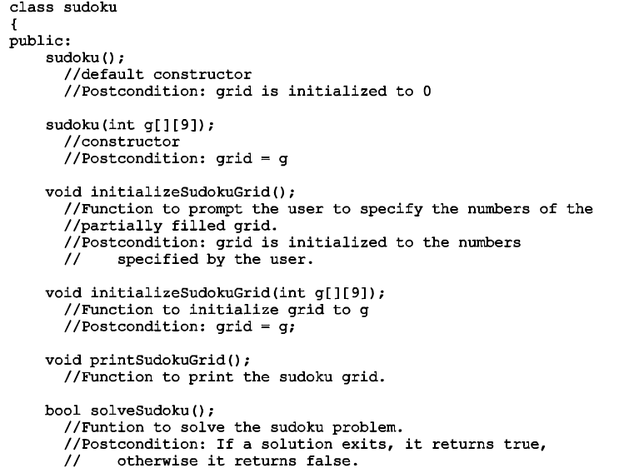
Recursion, Backtracking, and Sudoku (cont’d.)
Data Structures Using C++ 2E

Slide 54
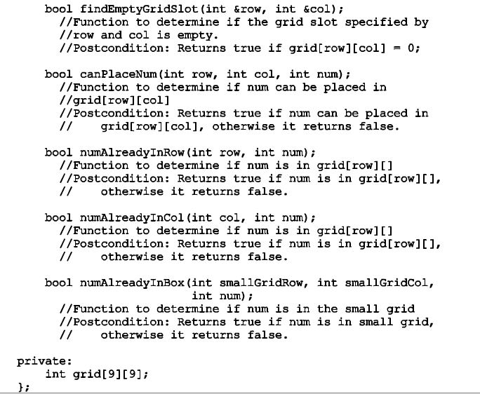
Recursion, Backtracking, and Sudoku (cont’d.)
Data Structures Using C++ 2E

Slide 55
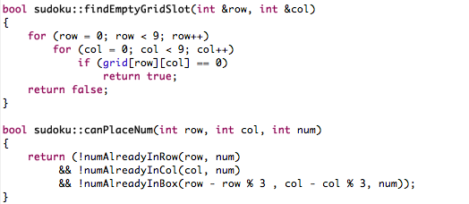
Recursion, Backtracking, and Sudoku (cont’d.)
Function definition
Data Structures Using C++ 2E

Slide 56
Discussion
Describe situations in which it is appropriate to use iteration over recursion.
Discuss possible recursive implementations of programs previously implemented iteratively
Data Structures Using C++ 2E

Slide 57
Summary
Recursion
  Solve problem by reducing it to smaller versions of itself
  Base(s): obtain the result directly
  General case(s): smaller version of itself, indirect result
Recursive algorithms implemented using recursive functions
  Direct, indirect, and infinite recursion
  No global/static variables!
Many problems solved using recursive algorithms
Choosing between recursion and iteration
  Nature of solution; efficiency requirements
Backtracking
  Problem solving; iterative design technique
Data Structures Using C++ 2E

Slide 58
Resources
http://cis.stvincent.edu/html/tutorials/swd/recur/recur.html
http://www.ibm.com/developerworks/linux/library/l-recurs/index.html
http://xlinux.nist.gov/dads/HTML/recursion.html
http://xlinux.nist.gov/dads//HTML/towersOfHanoi.html
http://www.cosc.canterbury.ac.nz/mukundan/dsal/ToHdb.html
http://math.rice.edu/~lanius/domath/hanoi.html
http://www.drdobbs.com/tools/parallelizing-n-queens-with-the-intel-pa/214303519
Data Structures Using C++ 2E

Slide 59
Self Exercises
Programming Exercises: 3, 5, 6, 7, 9, 10, 15
Data Structures Using C++ 2E

